Slide 1
Math Course I
Place Value
August 21, 2012
Mrs. Culverwell
Notes:
Decimals and whole numbers, rounding and estimating to add or subtract.

Slide 2
Warm up
Turn to page 6 and answer questions 21-24 in your notebooks.

Slide 3
What do you know?
List as many place values as you know in your notebook in the NOTES section. (Including decimals)

Slide 4
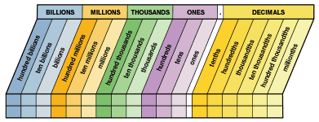
Place Value

Slide 5
vOCABULARY
Estimate: calculate approximately
Round: replacing a number by another number of approximately the same value
Sum: add
Difference: subtract

Slide 6
rounding
Example: Round to the nearest hundreds place.
16,562
Step 1: Locate the digit in the place value
16,562
Step 2: Look at the digit to the right of the one you
underlined (6)
RULES: - 5 through 9 you will round up the number that is UNDERLINED
- 4 through 0, you will keep the UNDERLINED number the same
Step 3 : Change the all the remaining numbers on the right to zeros
ANSWER: 16,600

Slide 7
Roudning
Round to the nearest thousands place. 23,650
Round to the nearest hundreds place. 4,519
Round to the nearest ones place. 165,203
Round to the nearest tens place. 45,379
Round to the nearest thousandths place. 155.347
Round to the nearest hundred-thousandths place. 2.36001

Slide 8
Apply Rounding to Estimate
Estimating Example (Video)

Slide 9
Practice
Now apply what you have learned to estimate the answers.
Practice
Extra Practice

