Slide 1
Warm up
Turn to page 6 and answer questions 21-24 in your notebooks.

Slide 2
Math Course I
Rounding Whole Numbers
August 22, 2012
Mrs. Culverwell

Slide 3
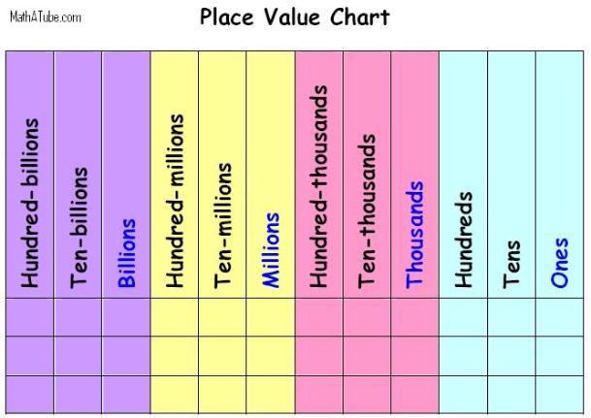
Place Value
Also on page 4.

Slide 4
vOCABULARY
Estimate: calculate approximately
Round: replacing a number by another number of approximately the same value
Sum: add
Difference: subtract

Slide 5
rounding
Example: Round to the nearest hundreds place.
16,562
Step 1: Locate the digit in the place value
16,562
Step 2: Look at the digit to the right of the one you
underlined (6)
RULES: - 5 through 9 you will round up the number that is UNDERLINED
- 4 through 0, you will keep the UNDERLINED number the same
Step 3 : Change the all the remaining numbers on the right to zeros
ANSWER: 16,600

Slide 6
ROUNDING
Round to the nearest thousands place. 23,650
Round to the nearest hundreds place. 4,519
Round to the nearest ones place. 165,203
Round to the nearest tens place. 45,379
Round to the nearest ten-thousands place. 155,347
Round to the nearest hundred-thousands place. 236,001

Slide 7
Apply Rounding to Estimate
Estimating Example

Slide 8
Practice
Now apply what you have learned to estimate the answers.
Practice
Extra Practice (1-3)
Extra Practice

