Slide 1
Math Course I
Place Value
August 21,2012
Mrs. Culverwell

Slide 2
Warm Up
Turn to page 2, complete questions 7-12 in the warm up section of your notebook.

Slide 3
What do you know?
Create a place value chart up to the hundred-billions in the work section of your notebook.

Slide 4
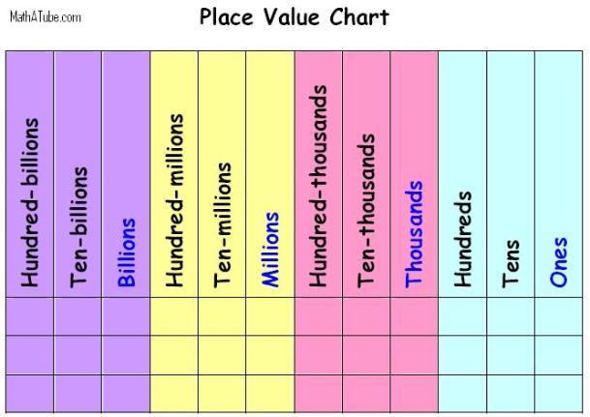
Place Value

Slide 5
Practice
What place is the 6 in? What is its value?
1,269
What place is the 3 in? What is its value?
23,001
What place is the 7 in? What is its value?
720,220
What place is the 8 in? What is its value?
280
What place is the 3 in? What is its value?
31,209
What place is the 4 in? What is its value?
240,001
What place is the 2 in? What is its value?
406,002
What place is the 9 in? What is its value?
12,900

Slide 6
Pop Quiz!
Tear a piece of paper in half and share with a neighbor or keep the other half for next time. 2 minutes! Go!
Recreate the place value chart you just learned.
You may start your homework early today if you finish
Don’t forget to hand in the quiz before you leave!

