Slide 1
Math Course I
Rounding Decimals
August 23,2012
Mrs. Culverwell

Slide 2
Warm up
Turn to page 7 and answer questions 26 - 28.
Notes:
Rounding decimal numbers to get a estimated answer when adding or subtracting.

Slide 3
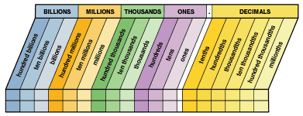
Place Value
Also on page 22.

Slide 4
vOCABULARY (review words)
Estimate: calculate approximately
Round: replacing a number by another number of approximately the same value
Sum: add
Difference: subtract

Slide 5
rounding
Example: Round to the nearest hundredths place.
17.345
Step 1: Locate the digit in the place value
17.345
Step 2: Look at the digit to the right of the one you
underlined (5)
RULES: - 5 through 9 you will round up the number that is UNDERLINED
- 4 through 0, you will keep the UNDERLINED number the same
Step 3 : Change the all the remaining numbers on the right to zeros or drop them.
ANSWER: 17.350 or 17.35

Slide 6
ROUNDING
Round to the nearest thousandths place. 23.6548
Round to the nearest hundredths place. 33.4456
Round to the nearest tenths place. 25.98
Round to the nearest whole number. 26.478
Round to the nearest ten-thousandths place. 0.15416
Round to the nearest hundred-thousandths place. 1.198643

Slide 7
Apply Rounding to Estimate
Rounding Example (video)
Rounding Example (video)

Slide 8
Practice
Now apply what you have learned to estimate the answers.
Practice
Extra Practice
Extra Practice

